Slide 1




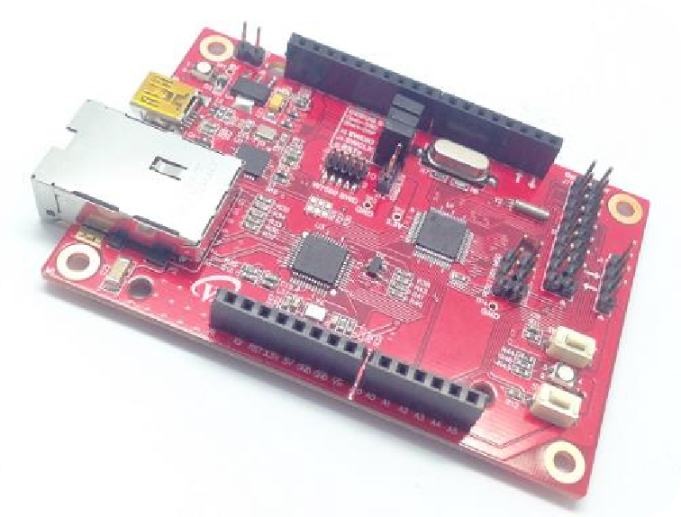


Start IoT Device development with WIZwiki-W7500
- Second round -

Slide 2
Index
1. The first step for IoT episode 2 - What is the Web Client?!
2. Let’s find out DHCP!
3. Let’s work with WizFi310
Let’s develop the IoT Device!
Develop Weather Forecast Device
Make Tweeting Machine
Cloud Server using dweet.io

Slide 3
The first step for IoT episode 2
What is the Client?!

Slide 4





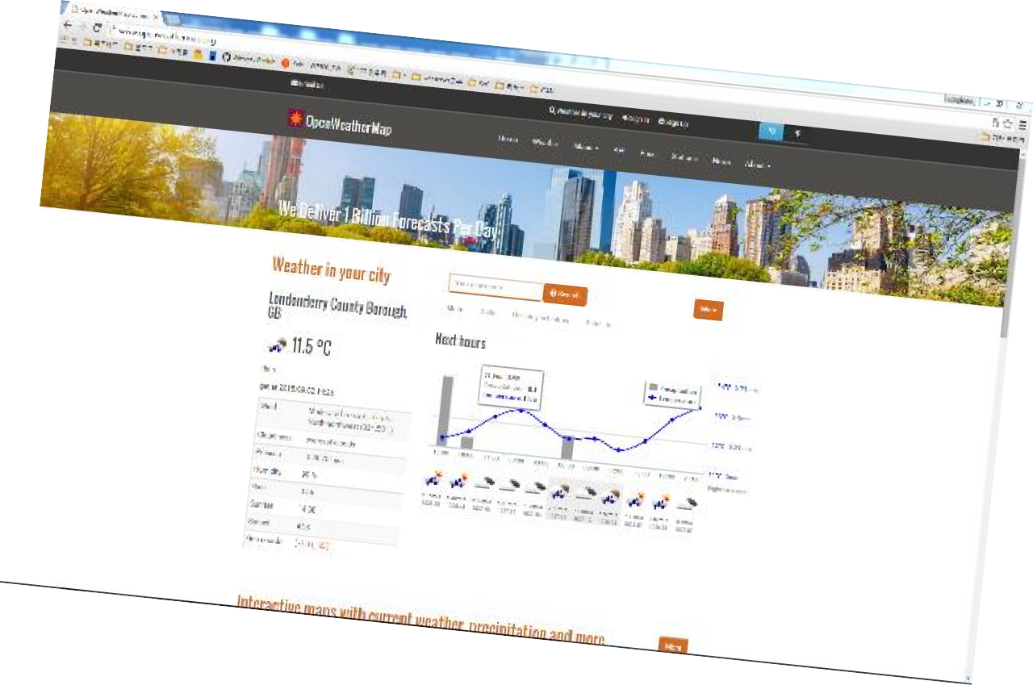





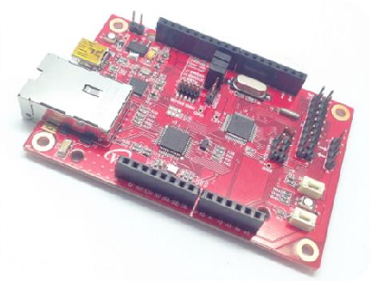

1. Web Client
Server
DHCP Server
www.openweathermap.org
WIZwiki-W7500
HTTP Request

Slide 5
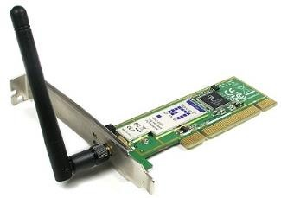
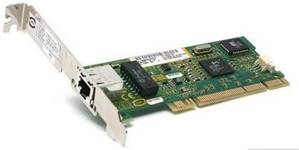
1. Web Client by HTTP
Application
Network application
PORT
Web Browser
Web Server
Socket Library
OS
IP
TCP
UDP
IP
Driver
Software
LAN Driver
Hardware
MAC

Slide 6
1. Web Client by HTTP
HyperText Transfer Protocol
2. It’s usually used to exchange HTML document and use port number 80.
3. Request-reply protocol is composed of Server and Client
4. Request method is as the following.
• GET : Request the transmission of data which is correspond to URL.
• POST : Send data which is processed by server.
• HEAD : It’s same request as GET but only request information about data
• PUT : Save data to the URL
• …
5. Response code
1xx : Informantion
2xx : Success
3xx : Redirection
4xx : Client Error
5xx : Server Error

Slide 7
Let’s find out DHCP!

Slide 8
2. What is DHCP?
1) Only if computer should have unique IP address is to access internet. But if DHCP is used, internet access is possible without unique IP address.
2) DHCP lease valid IP which can use for a period of time to Client that request IP. Therefore, if there is more computers than the number of available IP addresses, DHCP can dynamically reconfigure network by making short the lease time of IP address.

Slide 9
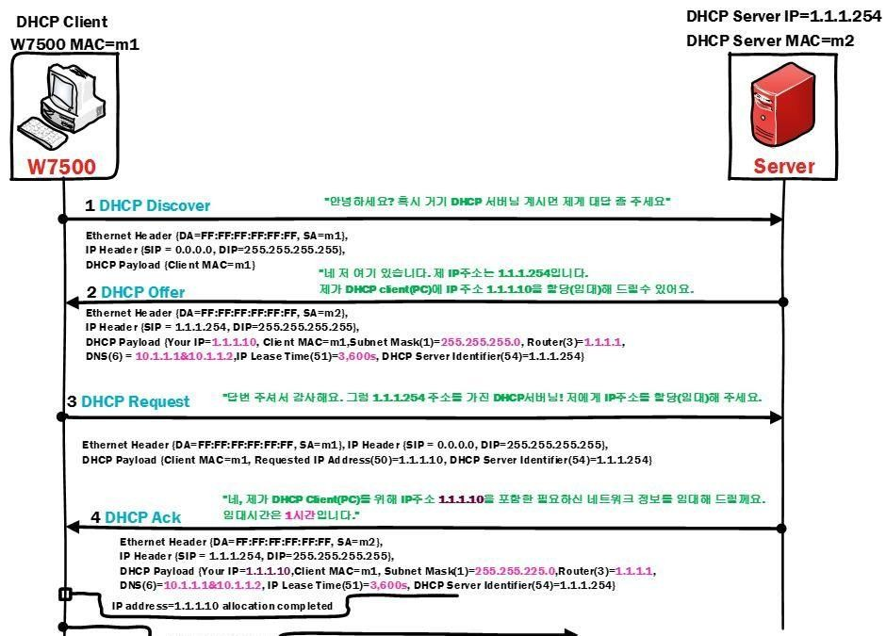
2. DHCP operation principle
https://www.youtube.com/watch?v=V69UAnkoYHM
Client -> Server : Locate DHCP server
Server -> Client : Response of DHCP server
Client -> Server : Request valid IP address
Server -> Client : Allocate valid IP address
Client -> Internet

Slide 10
Develop Weather Forecast Device
Web Client + DHCP + OLED Dispaly

Slide 11



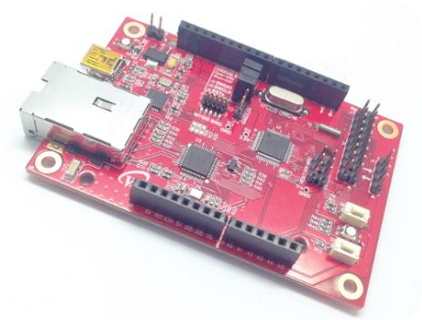
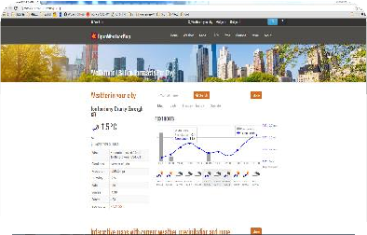
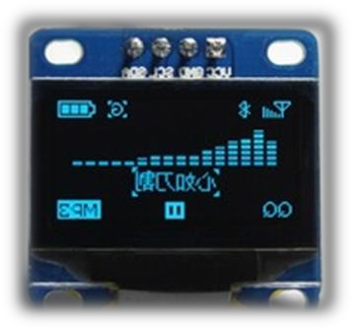


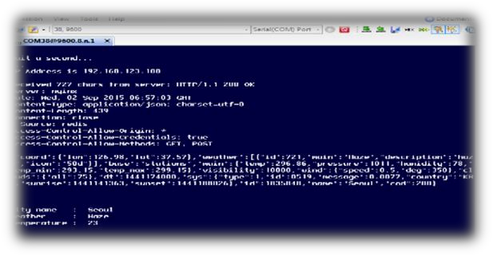

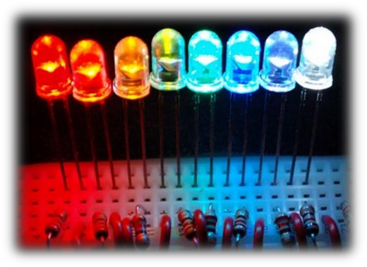
1. Weather Forecast Overview
HTTP Request
GPIO OUT

Slide 12
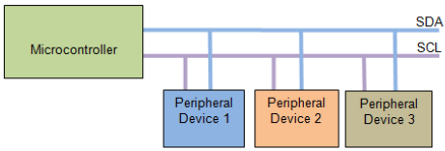

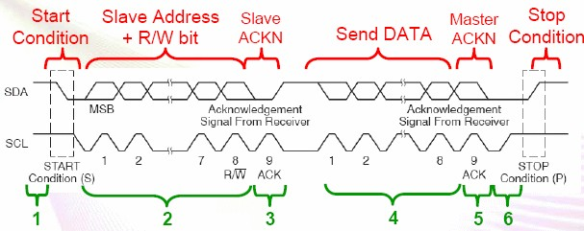
3. I2C Theory
1) I2C is synchronous serial data performance protocol between master and slave.
2) I2C use two serial buses.
3) data, 7bit address and 1bit ACK/non-ACK in the communication between master and slave using serial clock(SCL) and serial data(SDA) .

Slide 13
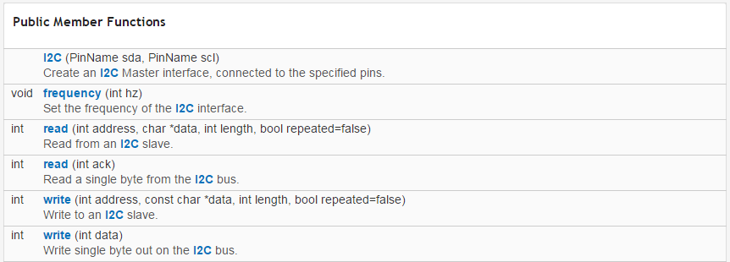
3. I2C Theory - I2C mbed Library
1) I2C Functions in mbed Library - 1
https://developer.mbed.org/handbook/I2C
https://developer.mbed.org/users/mbed_official/code/
Example link
Function description link
mbed/docs/tip/classmbed_1_1I2C.html
Set SDA, SCL pin.
Set I2C interface frequency.
Read data from Slave.
Slave address, pointer to read data, the number of bytes, false = repeat/ true = stop.
Read only 1byte from I2C
Write data from Slave.
Slave address, pointer to write data, the number of bytes, false = repeat/ true = stop.
Write 1byte using I2C
If ACK is sent, return ‘1’, Otherwise return ‘0’.

Slide 14
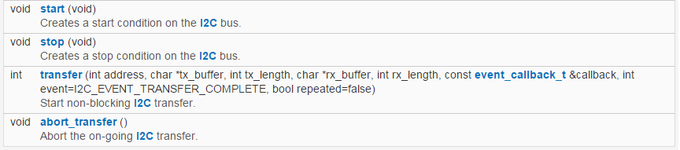
3. I2C Theory - I2C mbed Library
2) I2C Functions in mbed Library - 2
I2C Start() function
I2C Stop() function
Function is used to I2C transfer continuously .
Use to abort transfer() function which transfer continuously.

Slide 15
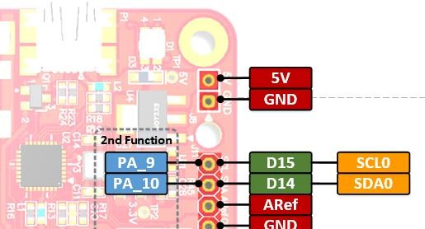
3. I2C Theory - I2C Pinout
LCD components library reference which is provided by mbed (AdaFruit_SSD1306 OLED)
I2C PinOut. SCL, SDA
I2C Pinout

Slide 16
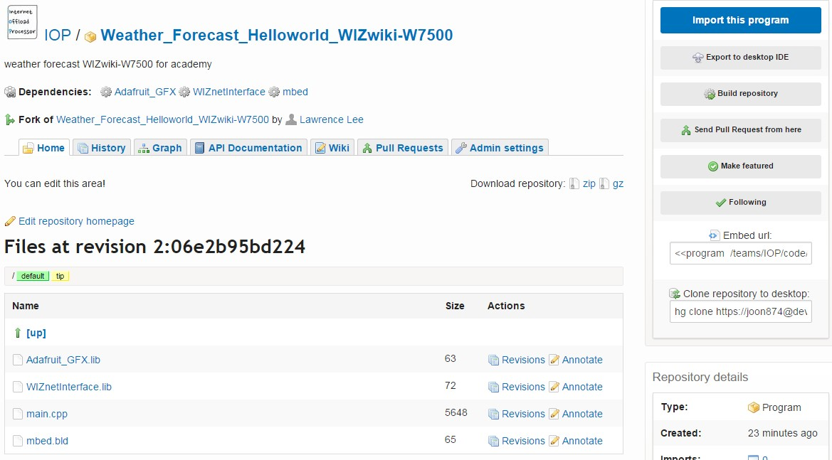
4. Weather Forecast - mbed Web Compiler
1) Import Weather Forecast
https://developer.mbed.org/teams/IOP/code/Weather_Forecast_Helloworld_WIZwiki-W750/
Click ‘Import this program' !!

Slide 17
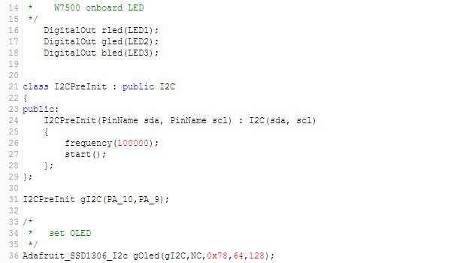
4. Weather Forecast - mbed Web Compiler
2) Code description - 1
Link the library you need using #include
Declare R,G,B LED of W7500 board as Digital Out
Initialize I2C frequency as 100KHz
• Declare PA_10 and PA_9 pin as SDA, SCL
• Enter Oled initial parameter (Pin information, reset pin, OLED slave address value, oled size128by64)

Slide 18
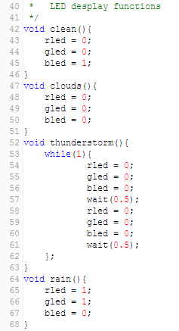
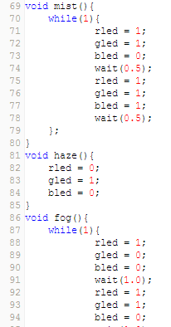

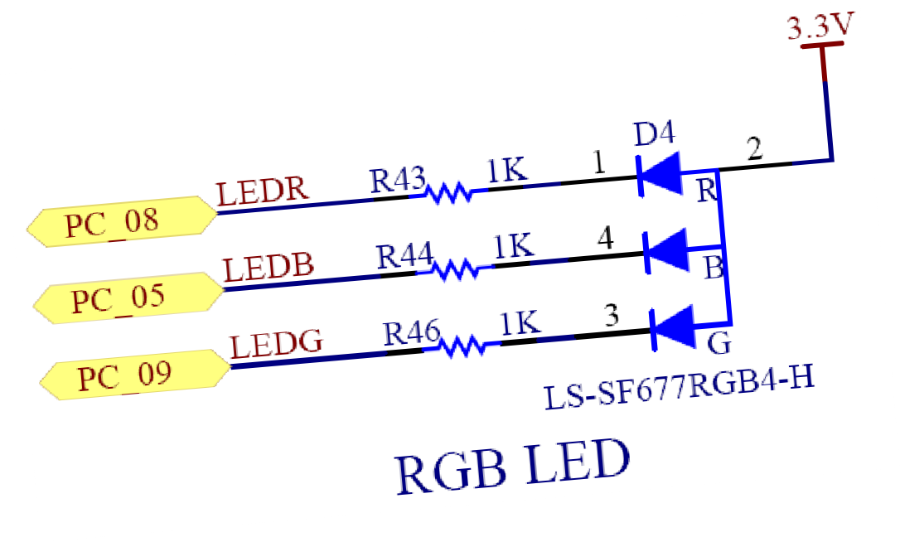
4. Weather Forecast - mbed Web Compiler
3) Code description - 2
Weather condition Functions
Clean()
Clouds()
Thunderstorm()
Rain()
Mist()
Haze()
Fog()
LED action by function

Slide 19
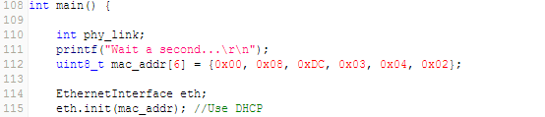
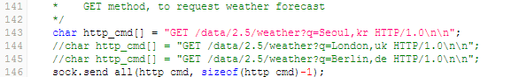
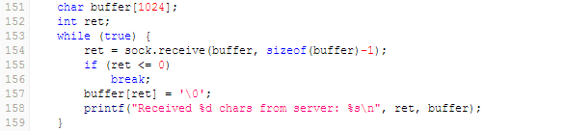
4. Weather Forecast - mbed Web Compiler
4) Code description - 3
Use DHCP
Connect to Openweathermap.org server
Request DATA you want to the server with GET Method using Send_all() function
Save the data which is sent by Server to buffer using Receive() function

Slide 20
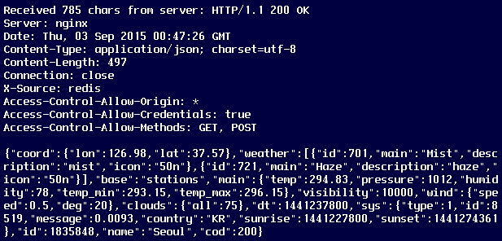
4. Weather Forecast - mbed Web Compiler
6) Data which is received from Server
Data which is received from Server
Data Type : json
Weather information contained within the data
Weather information which is needed for displaying

Slide 21
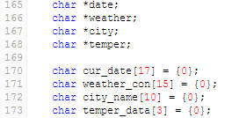
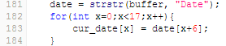
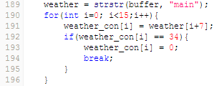
4. Weather Forecast - mbed Web Compiler
7) Code description - 4
Pointer value to bring initial address of string which is wanted from Buffer
Declare array to bring string which is wanted from Buffer
Save the first address value of string “Data” to buffer using strstr() function
• Save sequentially the characters indicated by the next 6th address from the saved address value using cur_data[x] = Data[x+6]
Import weather information after “main” from buffer in the same way with above

Slide 22
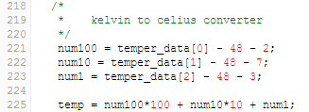
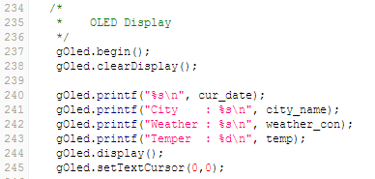
4. Weather Forecast - mbed Web Compiler
8) Code description - 5
Convert temperature parameter which is saved as Character type to decimal numbers. Convert Kelvin to Celsius by subtracting 273.
Display the weather information to OLED

Slide 23
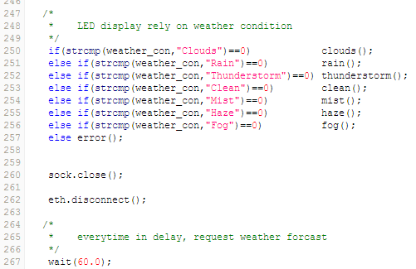
4. Weather Forecast - mbed Web Compiler
9) Code description - 6
Compare string using Strcmp() function and if it’s correct, run the weather condition function declared above.
Request the weather information from Server every 60 seconds

Slide 24
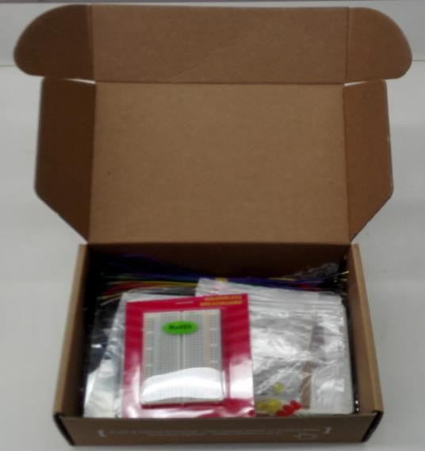
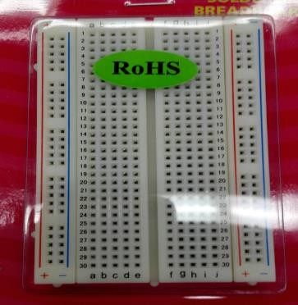
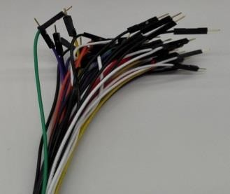
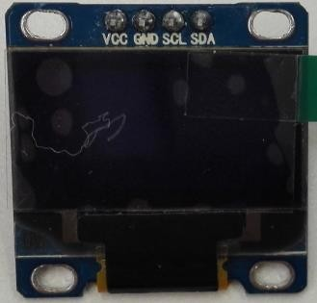
5. H/W implementation - W7500 Starter Kit
1) Use WIZwiki-W7500 Starter Kit
OLED

Slide 25
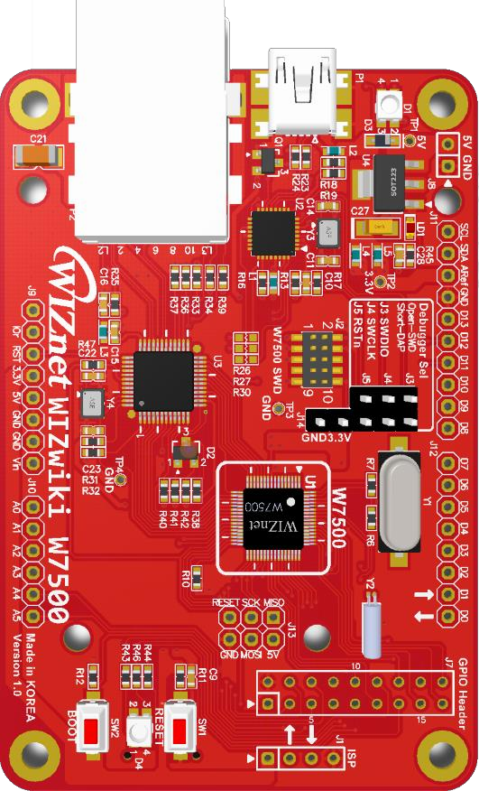
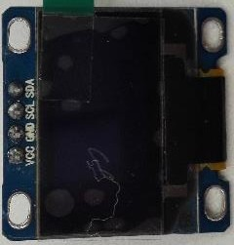
5. H/W- W7500 Starter Kit
2) Breadboard Layout
SCL:SCL
SDA:SDA
3.3V
GND
GND:GND
3.3V:VCC

Slide 26
Make Tweeting Machine
Web Client + DHCP + OLED Dispaly

Slide 27





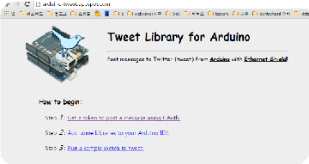

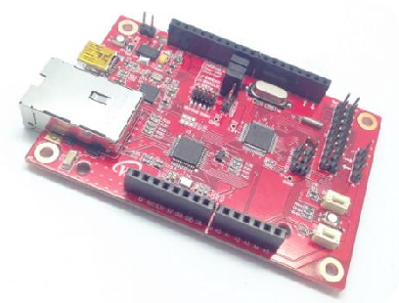


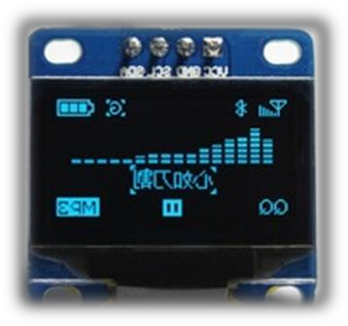

1. Tweeting Machine Overview
DHCP Server
Proxy Server
WIZwiki-W7500

Slide 28
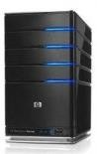




1. Web Client by HTTP
Request
Response
Request
Request
Response
Response
Cache

Slide 29

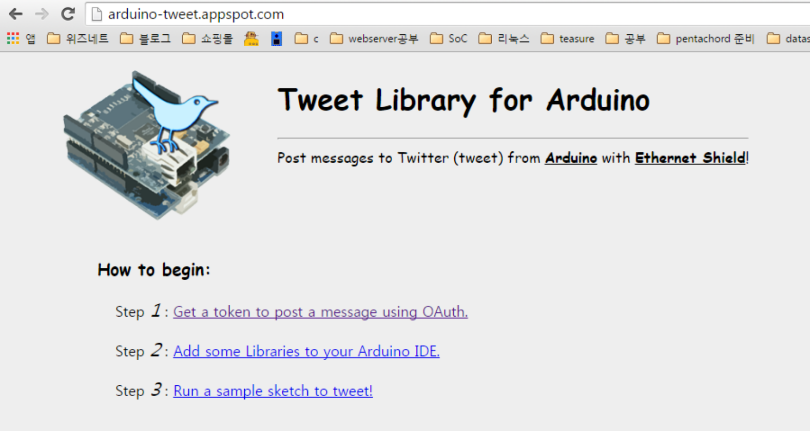
3. Use Proxy Server
1) Import Token value from Proxy Server - 1
1
http://arduino-tweet.appspot.com/
2
Click

Slide 30
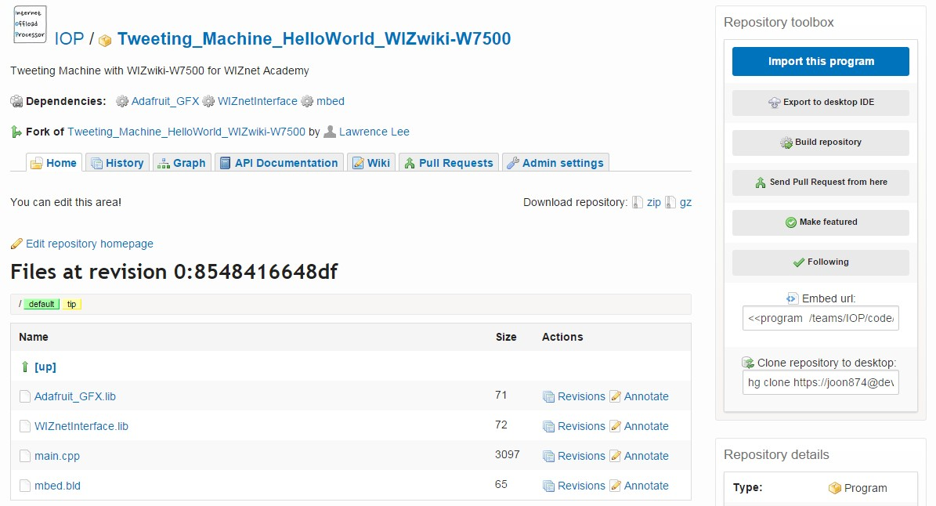
4. Tweeting Machine - mbed Web Compiler
1) Import Weather Forecast
https://developer.mbed.org/teams/IOP/code/Tweeting_Machine_HelloWorld_WIZwiki-W750/
Click Import this program !!

Slide 31
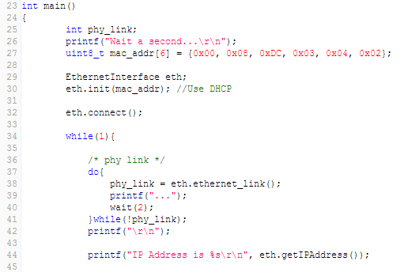
4. Tweeting Machine - mbed Web Compiler
3) Code description - 2
Use DHCP
Print IP information which is received from DHCP Server

Slide 32
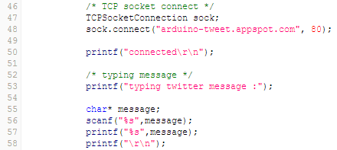
4. Tweeting Machine - mbed Web Compiler
4) Code description - 3
Connect Proxy Server
Input the message which will be sent using the keyboard and save it

Slide 33
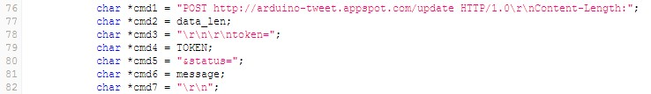
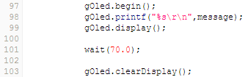
4. Tweeting Machine - mbed Web Compiler
5) Code description - 4
Display message sent to OLED
Data which will send to Proxy Server
Again operate after 70 seconds

Slide 34
Cloud Server using dweet.io
Web Client + DHCP + OLED Dispaly

Slide 35







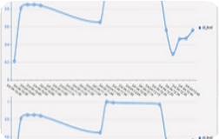





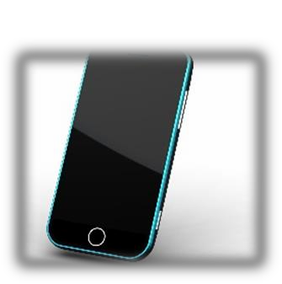

1. Cloud Server
DHCP Server
Cloud Server
WIZwiki-W7500

Slide 36
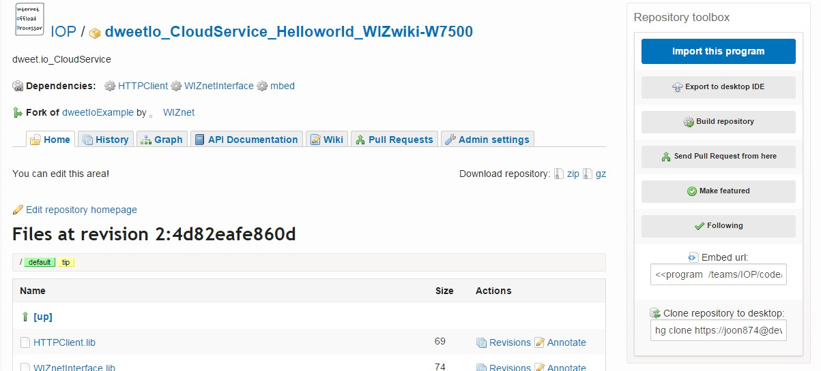
3. Cloud Service - mbed Web Compiler
1) Import Weather Forecast
https://developer.mbed.org/teams/IOP/code/dweetIo_CloudService_Helloworld_WIZwiki-/
Click Import this program!!

Slide 37

3. Cloud Service - mbed Web Compiler
2) Code description - 1
#include 로 필요한 라이브러리를 링크
DHCP 를 이용해 유효한 IP 할당 받기위해
‘1’로 설정
Enter MAC address
Things 의 아날로그 값을 읽어올 PIN

Slide 38

3. Cloud Service - mbed Web Compiler
3) Code description - 2
Input the name of Things inputted on dweet.io
POST name of Things and analog value as fixed data format to Cloud Server
Update the change of data to Cloud Server every 5 seconds

Slide 39



4. H/W implementation - Potentiometer
3) Use WIZwiki-W7500 Starter Kit
GF063PK B103

Slide 40




4. H/W implementation - Potentiometer
4) Breadboard Layout using WIZwiki-W7500 Starter Kit
3.3v:VCC
VCC
3.3V
WIPER
GND
3.3V
A0:WIPER
A1:V_out
1.6V
3.3v
GND
GND
GND
A0
VCC
V_out
GND
A1
GND:GND

Slide 41


5. Cloud Service - mbed Web Compiler
5) Check data from Cloud Server
1
Data in text format
Copy and paste the address printed out on Serial Terminal
2
Direct input in the address bar
http://dweet.io/follow/nameYouWant
Graph updated in real time
Name of Things which is inputted on dweet.io

Slide 42

Wiznet WizFi310 Wi-Fi Shield

Slide 43
What is WizFi310 ? ? ?
WizFi310 offers a quick, easy, and cost-effective way for device and appliance manufacturers to add WiFi capabilities to their products. WizFi310 provides UART interfaces which enable connections to any embedded design utilizing an 8/16/32-bit microcontroller via simple AT commands.
WizFi310 is compliant with 802.11b/g/n.

Slide 44
Features of WizFi310
Single band 2.4GHz IEEE802.11b/g/n Wi-Fi module
72.2Mbps receive PHY rate and 72.2Mbps transmit PHY rate using 20MHz bandwidth and 150Mbps receive PHY rate and 150Mbps transmit PHY rate using 40MHz bandwidth.
Low power consumption & excellent power management performance extend battery life.
Easy for integration into mobile and handheld device with flexible system configuration.
Serial Interface : UART and UART Max Baud : 921600 bps
Soft AP
Enough memory retention
Wi-Fi Security (WEP, WPA/WPA2PSK)
L2 Switching
OTA (Over The Air F/W Upgrading)

Slide 45
WizFi310 Wi-Fi Station/Client

Slide 46

Download the example from the following link:- https://developer.mbed.org/users/ajeet3004/code/WizFi310_Station/

Slide 47


Include and Link the libraries
Set the SSID, Password of the network you want to connect
Set the baud rate to 115200
Initialize the WizFi310
Connect the WizFi310 with the defined SSID and password and WizFi310 mode as WM_STATION
Print the IP address of WizFi310

Slide 48
WizFi310 Wi-Fi Access Point/Server

Slide 49

Download the example from the following link:- https://developer.mbed.org/users/ajeet3004/code/WizFi310_AP/

Slide 50


Include and link the libraries
Set the SSID and Password for the server
Set the baud rate to 115200
Initialize the WizFi310
Set the IP Address, Subnet Mask and gateway address of the server
Start the WizFi310 with the defined SSID and password as WM_AP
Print the IP Address of the server

Slide 51
QnA Thank you

